Slide 1
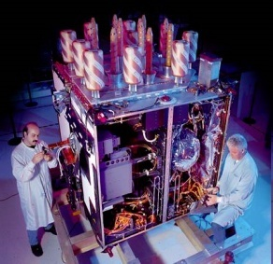


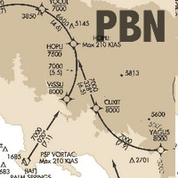
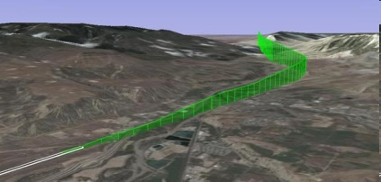

Hong Kong PBN implementation and Integrating RNP AR into a Busy Airspace – Success and Challenges
10 June 2015
Notes:
1
2015/6/5
1

Slide 2

Content
Hong Kong PBN Implementation Roadmap
RNP AR APCH Implementation
QA
2
Notes:
2015/6/5
2

Slide 3
Hong Kong PBN Implementation Roadmap (Overview)
AIRSPACE | SHORT TERM (2008-2012) | MEDIUM TERM (2013-2016) | LONG TERM (Beyond 2016)
Approach | Implemented RNP AR APCH Procedure to all RWY | Considering use of appropriate Nav. Spec., e.g. Advance RNP APCH, within approach airspace | Conduct GBAS trials with airlines and consider use of GBAS as backup to the ILS and enhanced PBN operations at the HKIA Consider use of other Nav. Spec. that suits the operation in HK Consider mandate the Nav. Spec. selected for aircraft operating within approach airspace by 2016+ Achieve 100% implementation of the Nav. Spec. selected within approach airspace
Terminal (SID/STAR) | Issued mandate for RNP1 | Implemented RNP1 in 2014 | Consider use of other Nav. Spec. that suits the operation in HK, e.g. ARNP
En-route | Applied 50NM Longitudinal Separation on RNP10 Routes Issued requirement for RNP4 | Implemented RNP4 on M771/ L642 in 2014 | Consider mandate better Nav. Spec. in accordance with the ICAO regional roadmap, e.g. RNP 2
3
3
Notes:
RNP AR due Intermediate approach criteria

Slide 4
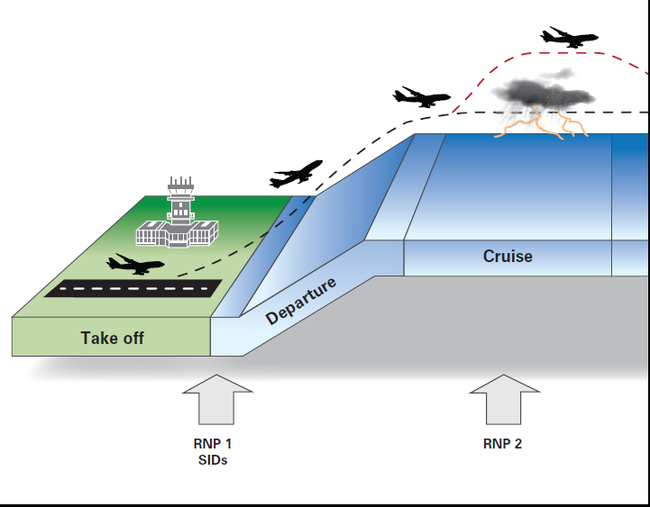
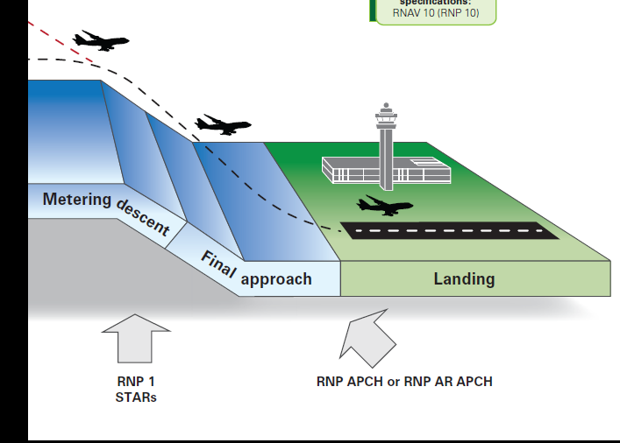
Hong Kong PBN Implementation Current Status
* Drawing courtesy of CASA, Australia, PBN Booklet
RNP1 SIDs
RNP4
RNP1 STARs
RNP AR APCH
considering RNP2 to meet ICAO Seamless ATM Plan's target)
considering Adv-RNP once OPS approval and Charting criteria are available

Slide 5


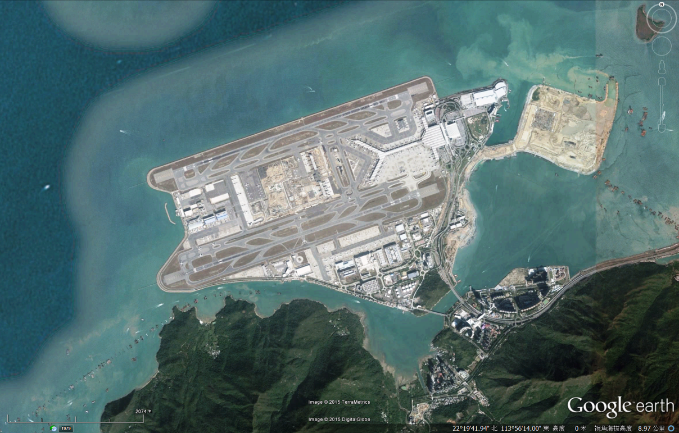
RWY25 L/R
RWY07 L/R
5

Slide 6
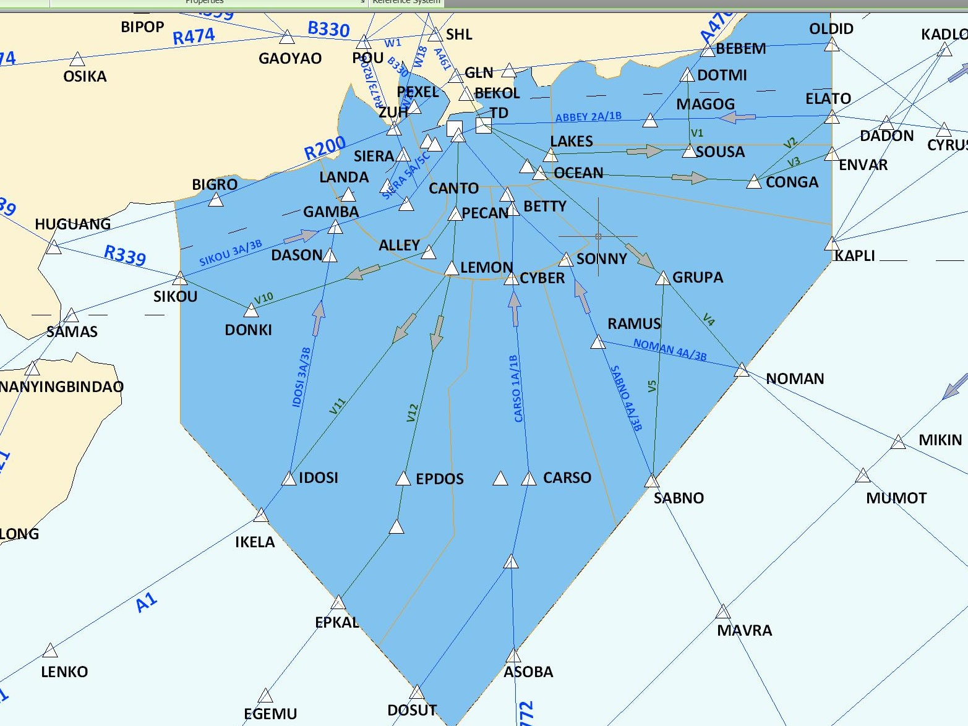
HKIA ARR & DEP
SURFA
6

Slide 7
MVA
R
A
D
A
R
V
E
C
T
O
R
I
N
G
Main Stream of Approach Flow
2.25 nm

Slide 8
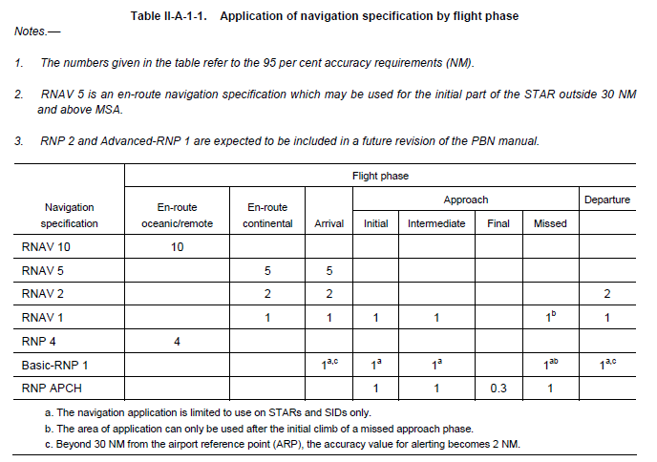
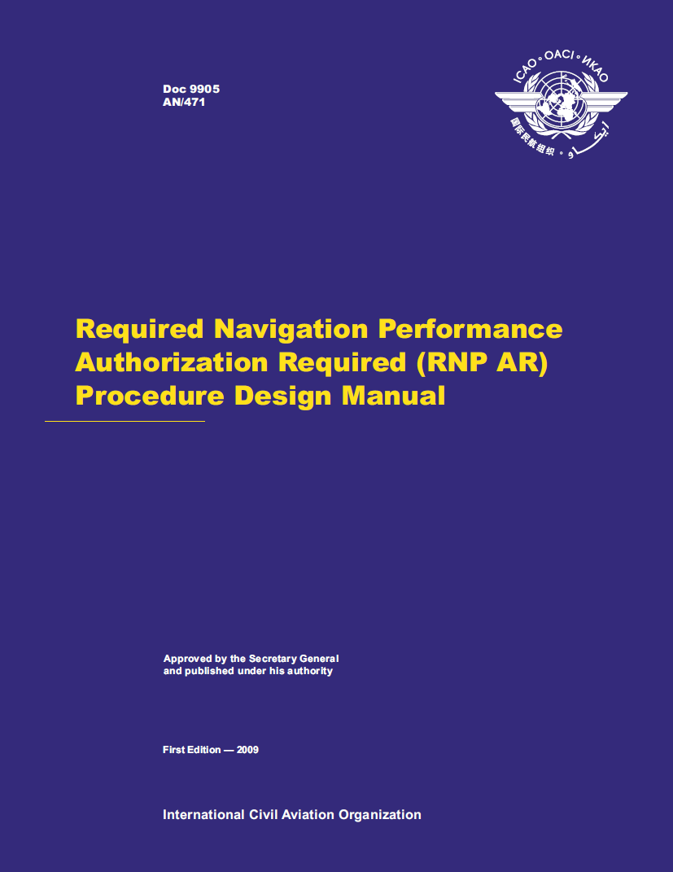
Application of navigation specification by flight phase
Obsolete ICAO Doc 9613 PBN Manual 3rd edition
Notes:
2 Nav Spec for RNP APCH, due terrain we need to use RNP AR

Slide 9
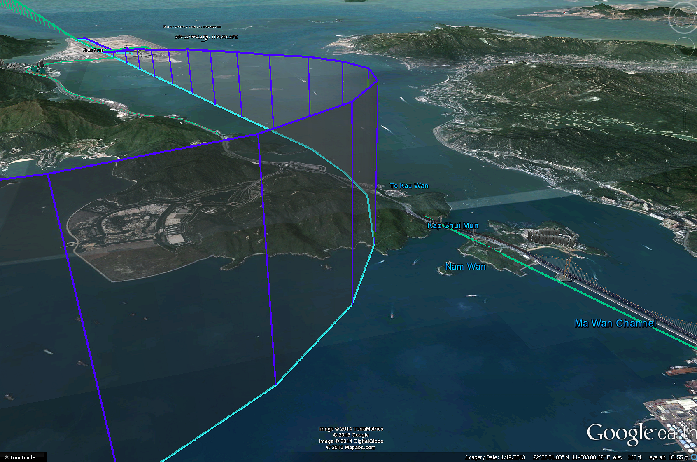
Hong Kong RNP AR APCH Summary
RWY 07
RNP AR APCH L/R as ILS Backup x2
RNP AR APCH L/R for contingency x2
RWY25
RNP AR APCH L/R as ILS Backup x2
RNP AR APCH L/R to enhance accessibility x2
No. of RNP AR APCH x8
9

Slide 10
Content
Hong Kong PBN Implementation Roadmap
RNP AR APCH implementation
QA
10
Notes:
2015/6/5
10

Slide 11
RNAV(RNP) y RWY25L (ILS Backup procedure)
RNAV(RNP) z RWY25L (Alternate approach procedure for ILS) (GUAVA Approach)

Slide 12
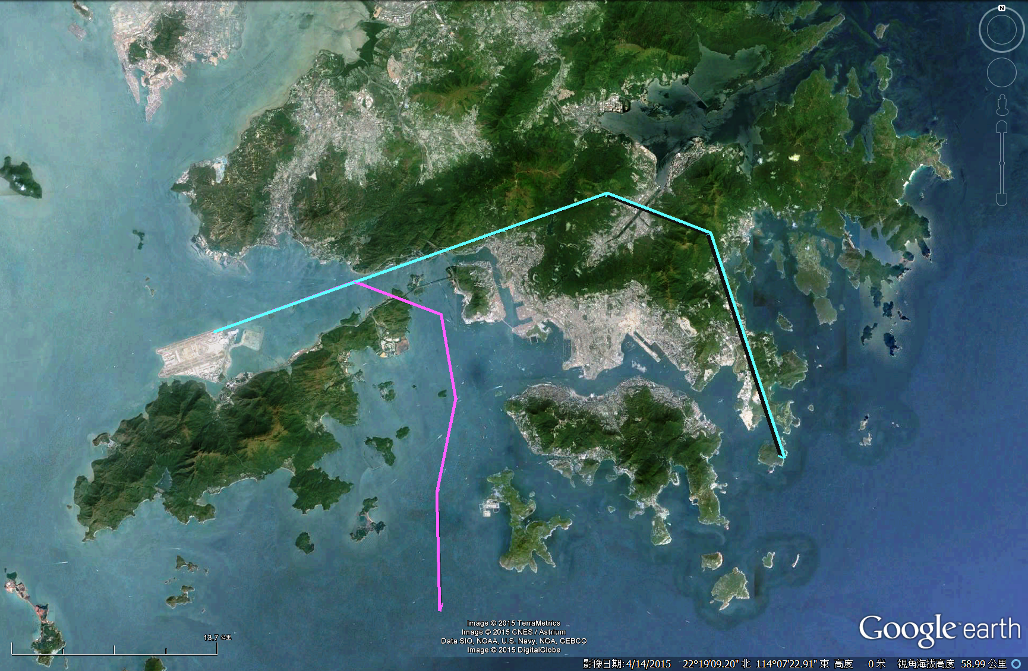
Advantage of the GUAVA approach
Hong Kong
Highest Terrain
Tai Mo Shan
Built-up Area
12

Slide 13
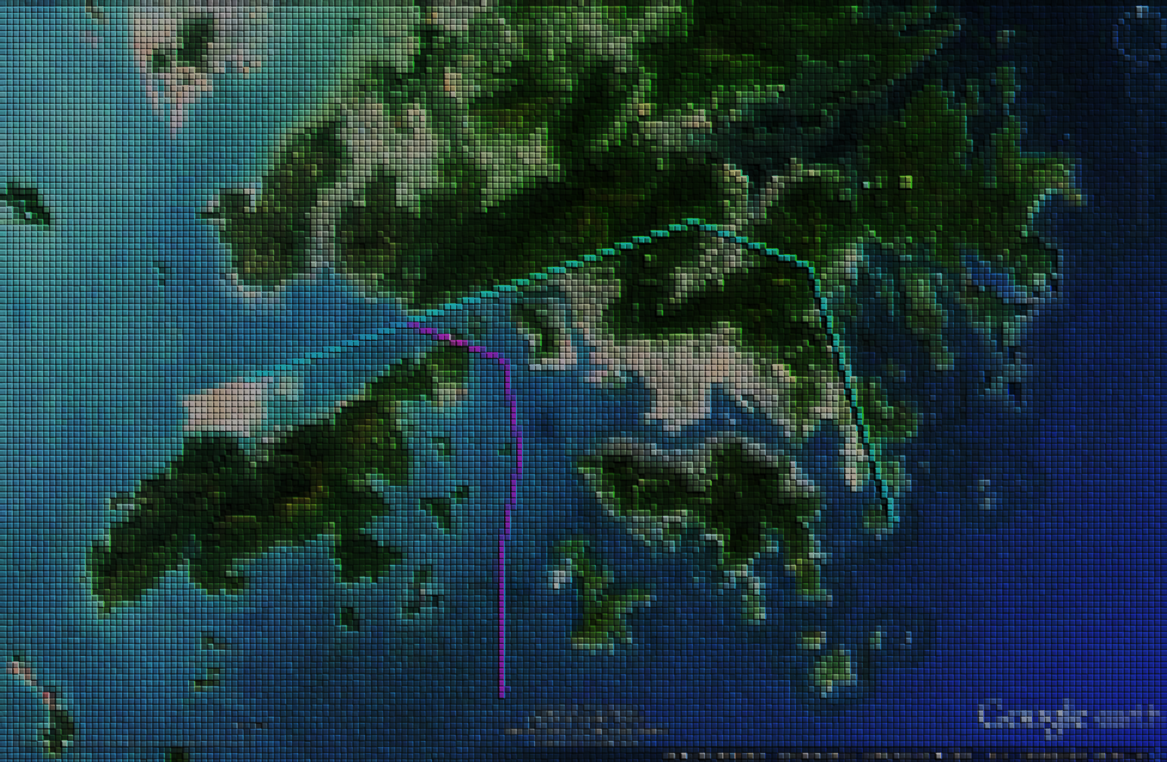
Advantage of the GUAVA approach
Enhance the accessibility
Reduce track miles for traffic from North and West
Enhance environmental factors
  Noise and
  Emission

Slide 14
Challenges for RNP AR APCH Implementation
Stringent requirements on
  Data collection
  Airline operators fleet equipage + pilot training requirement
  Validation
  Publication
  Safety Assessment
ATC procedures integration
Notes:
Publication is not stringent but insufficient info

Slide 15

Overcome the Challenge!
Face the Tiger!
Participate ICAO meetings
  PBN Task Force, COSCAP, FPP etc
Hong Kong PBN Planning and Implementation Team (PBN PIT)
  Local airlines,
  ANSP,
  Regulators and
  Engineers
* Image courtesy of https://www.mazech.com/tiger_on_roof
Notes:
RF turn is not an option!
We found the issue one RNP APCH for one FMS

Slide 16

Overcome the Challenge by all stakeholders - 1
  Meetings to sort out issues like operational approval, procedure design, database
  Flight simulators for demonstration and validation
  Actual demonstration flight
  Half year operational trials to collect data on
      Tracking accuracy
      Noise measurement and other environmental factors

Slide 17
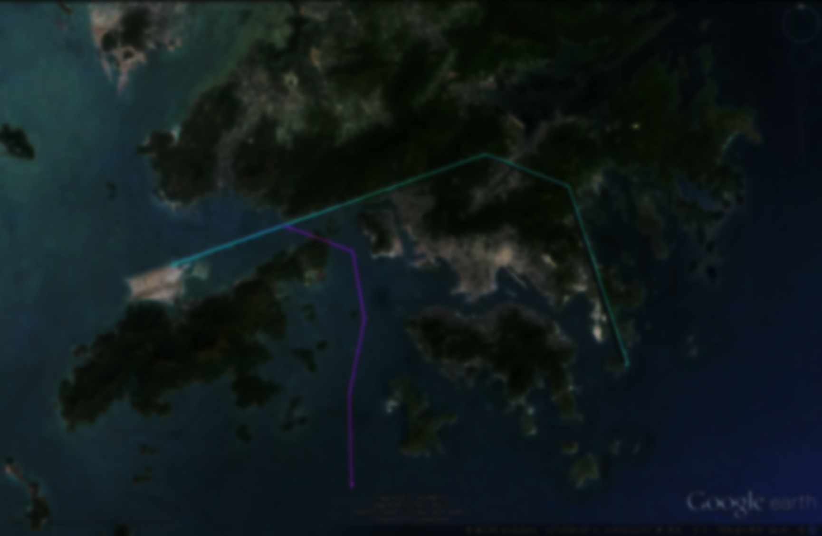
Overcome the Challenge with ATC
Different flight paths posed extreme challenge to ATC
  Different flight path subject to different wind components
  Issues on Airspace integrity
  25%- of aircraft operate in Hong Kong are RNP AR approved
  Hong Kong is reaching maximum movement capacity : 99+% slot allocated
Meetings with ATC to know their needs
  Additional buffer is added for separation between mainstream and new procedure
  New waypoints are added strategically to provide extra visual reference for ATC
17

Slide 18
Conclusion:
Mixed Nav Spec environment is not efficient for busy airspace like Hong Kong
New Nav Spec with similar performance, lower Operation Approval and Implementation cost but majority population is the best solution
= Advanced RNP
Questions?
18
Notes:
RF is not a mandate requirement on RNP AR but on ARNP
If mandate, population is expected to be low
Ops approval guidance is not in 9997 yet and no charting criteria in Annex 4

Slide 19

Thank you for your attention

